Slide 1
USE CASES
T1 Strategy, Governance and Organisation

Slide 2
From fragmented initiatives to governed AI across public administration
Strategy, Governance & Organisation
Implementation of the Italian Strategy for Artificial Intelligence 2024–2026 in Public Administration
2
Challenge / opportunity
3
Proposed use of AI
4
Scope
Rapid change and fragmented initiatives risk silos, uneven adoption and regulatory non-compliance across national and local administrations.
Deploy generative AI and automation for decision support, internal operations, document drafting and citizen assistance, with mandatory human oversight.
A nationwide governance framework for central, regional and local authorities, AgID and the Department for Digital Transformation; no fully autonomous decisions.
5
Expected outcome
6
Environmental + digital contribution
7
Key conditions
A more agile and trustworthy administration with interoperable AI, faster and more accessible services, reduced bureaucracy and ethical compliance.
Promotes sustainable infrastructure, environmental monitoring and energy efficiency while strengthening data quality, interoperability, cybersecurity and AI skills.
EU AI Act and national compliance; high-quality interoperable data; human-in-the-loop controls; workforce training; and reusable cross-administration solutions.
MAIN TAKEAWAYS
01
02
03
04
Governed AI,
scaled across government
One strategic direction
Human authority retained
Trustworthy foundations
Reusable public value
Common governance and guidelines align national, regional and local adoption and investment.
AI supports workflows and decisions; accountable officials validate every final administrative outcome.
Interoperable data, privacy, security, ethics and workforce capability determine sustainable adoption.
Shared solutions reduce duplication, speed service delivery and extend benefits across administrations.
A unified strategy turns separate AI initiatives into reusable public capability while keeping rights, accountability and final decisions firmly in human hands.
Source: User-provided AI use case description, “Implementation of the Italian Strategy for Artificial Intelligence 2024–2026 in Public Administration”.
Notes:
Source: User-provided content in this conversation.
[Sources]
- User-provided content in this conversation
- EEA/Eionet reference design: FOEN_Internal_Environmental_Data_Chatbot.pptx
[/Sources]

Slide 3
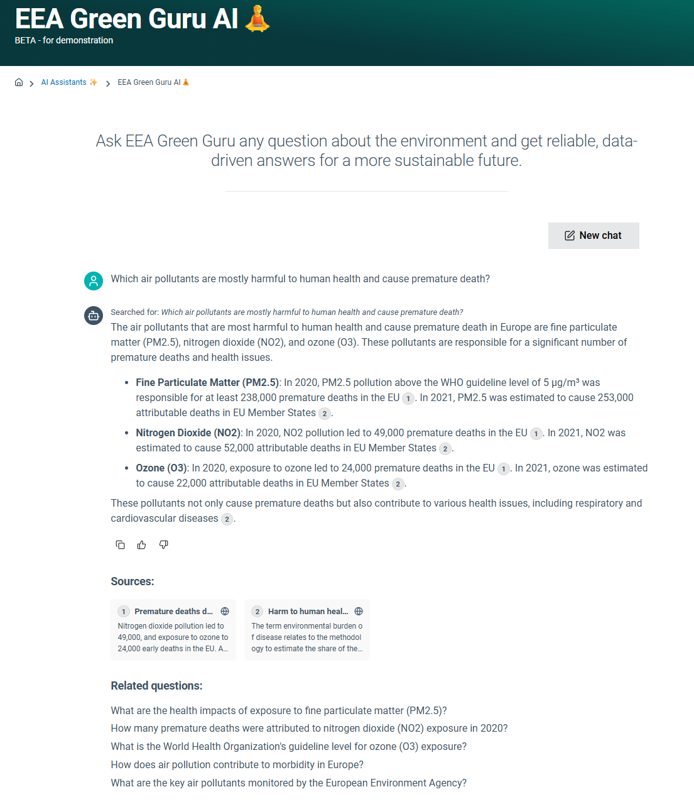
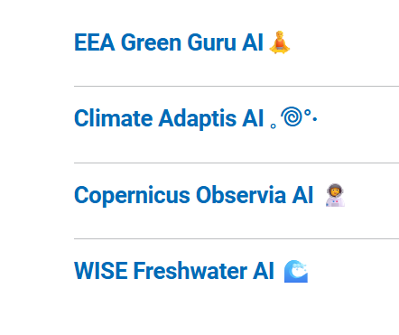
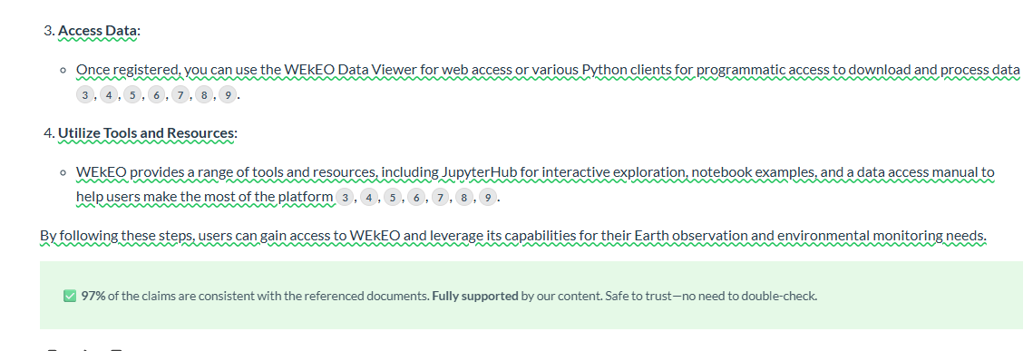
AI is a core part of the Digital Capability Strategy
People, Skills & Ways of Working
Worker productivity and production of knowledge and reports
Knowledge exploration services
Data analysis, exploration, visualisation, advanced analytics, image treatment and quality
Notes:
We need to ensure that there is clear reference to the sources of the answers, and claim verification step. Additionally, we can collect feedback on accuracy and usefulness by using the thumbs up and down.

Slide 4
USE CASES
T2 People, Skills and Ways of Working

Slide 5
From onboarding friction to instant Teams guidance
People, Skills & Ways of Working
Teams Helpdesk Agent
2
Challenge / opportunity
3
Proposed use of AI
4
Scope
New reporters and Expert Group members must search across many pages and documents to locate data, rules, contacts and deadlines.
A Teams-based assistant answers questions on document locations, reporting registration, procedures, rules and relevant contacts.
Available in the existing EEA Teams environment to authorised channel members, focused on onboarding and operational guidance.
5
Expected outcome
6
Environmental + digital contribution
7
Key conditions
Faster onboarding, clearer responsibilities and earlier visibility of short-term deadlines, with less time spent searching.
Reduces search effort and supports accessibility, interoperability and future workflow automation. Environmental gains are likely modest.
GDPR-compliant access, reliable and current content, permission-aware answers, central integration and clear ownership of the knowledge base.
MAIN TAKEAWAYS
01
02
03
04
Guidance at the point of need
Faster onboarding
Work where knowledge lives
Access governed by design
Central, reusable service
New users can find documents, responsibilities and deadlines through one conversational entry point.
Integration in Teams brings guidance into the environment already used by the community.
Answers must respect existing permissions, GDPR requirements and authoritative source ownership.
A centrally managed agent avoids Member State infrastructure and can support further automation.
The assistant turns fragmented Teams content into direct, permission-aware guidance for new reporters and group members.
Source: User-provided AI use case description, “Teams Helpdesk Agent”.
Notes:
Source: User-provided AI use case description, “Teams Helpdesk Agent”.
[Sources]
- User-provided content in this conversation
- EEA/Eionet reference design: FOEN_Internal_Environmental_Data_Chatbot.pptx
[/Sources]

Slide 6
SmartLab — in-house capability building for digitalisation and AI
People, Skills & Ways of Working
From scarce training capacity to practical AI literacy
2
Challenge / opportunity
3
Proposed use of AI
4
Scope
AI literacy is mandatory, but central training capacity is scarce and not tailored to environmental work. Staff need fast, practical learning linked to their own tasks.
An in-house programme enables AI use through four pillars: fundamentals, responsible AI, working culture and methods, and practical application.
Portfolio staff; virtual and in-person sessions, an internal catalogue, curated external offers and expert-led sessions. No broad certification or specialist model training.
5
Expected outcome
6
Environmental + digital contribution
7
Key conditions
Staff build AI literacy without waiting for scarce external capacity and apply AI methods to environmental and administrative tasks.
Builds AI capability where environmental expertise sits, supports evidence work and meets AI Act literacy needs with responsible-AI skills embedded.
Small-team delivery, volunteer experts, verification of AI-assisted search, restricted platform access, limited impact measurement and careful scaling.
MAIN TAKEAWAYS
01
02
03
04
AI literacy, built from within
Learn by doing
Responsible by design
Scale through peers
Reusable model
Low-threshold sessions connect AI concepts directly to environmental and administrative tasks.
Ethics, critical appraisal and verification are taught alongside tools, prompting and methods.
KI-Lab staff and internal experts extend central provision without duplicating the federal academy.
The four-pillar curriculum, session designs and provider-search prompt can transfer to other agencies.
SmartLab turns internal expertise into a practical learning system that builds responsible AI capability faster, closer to environmental work and with less dependence on procurement.
Source: User-provided AI use case description, “SmartLab — in-house capability building for digitalisation and AI”.
Notes:
Source: User-provided AI use case description, “SmartLab — in-house capability building for digitalisation and AI”.
[Sources]
- User-provided content in this conversation
- EEA/Eionet reference design: FOEN_Internal_Environmental_Data_Chatbot.pptx
[/Sources]

Slide 7
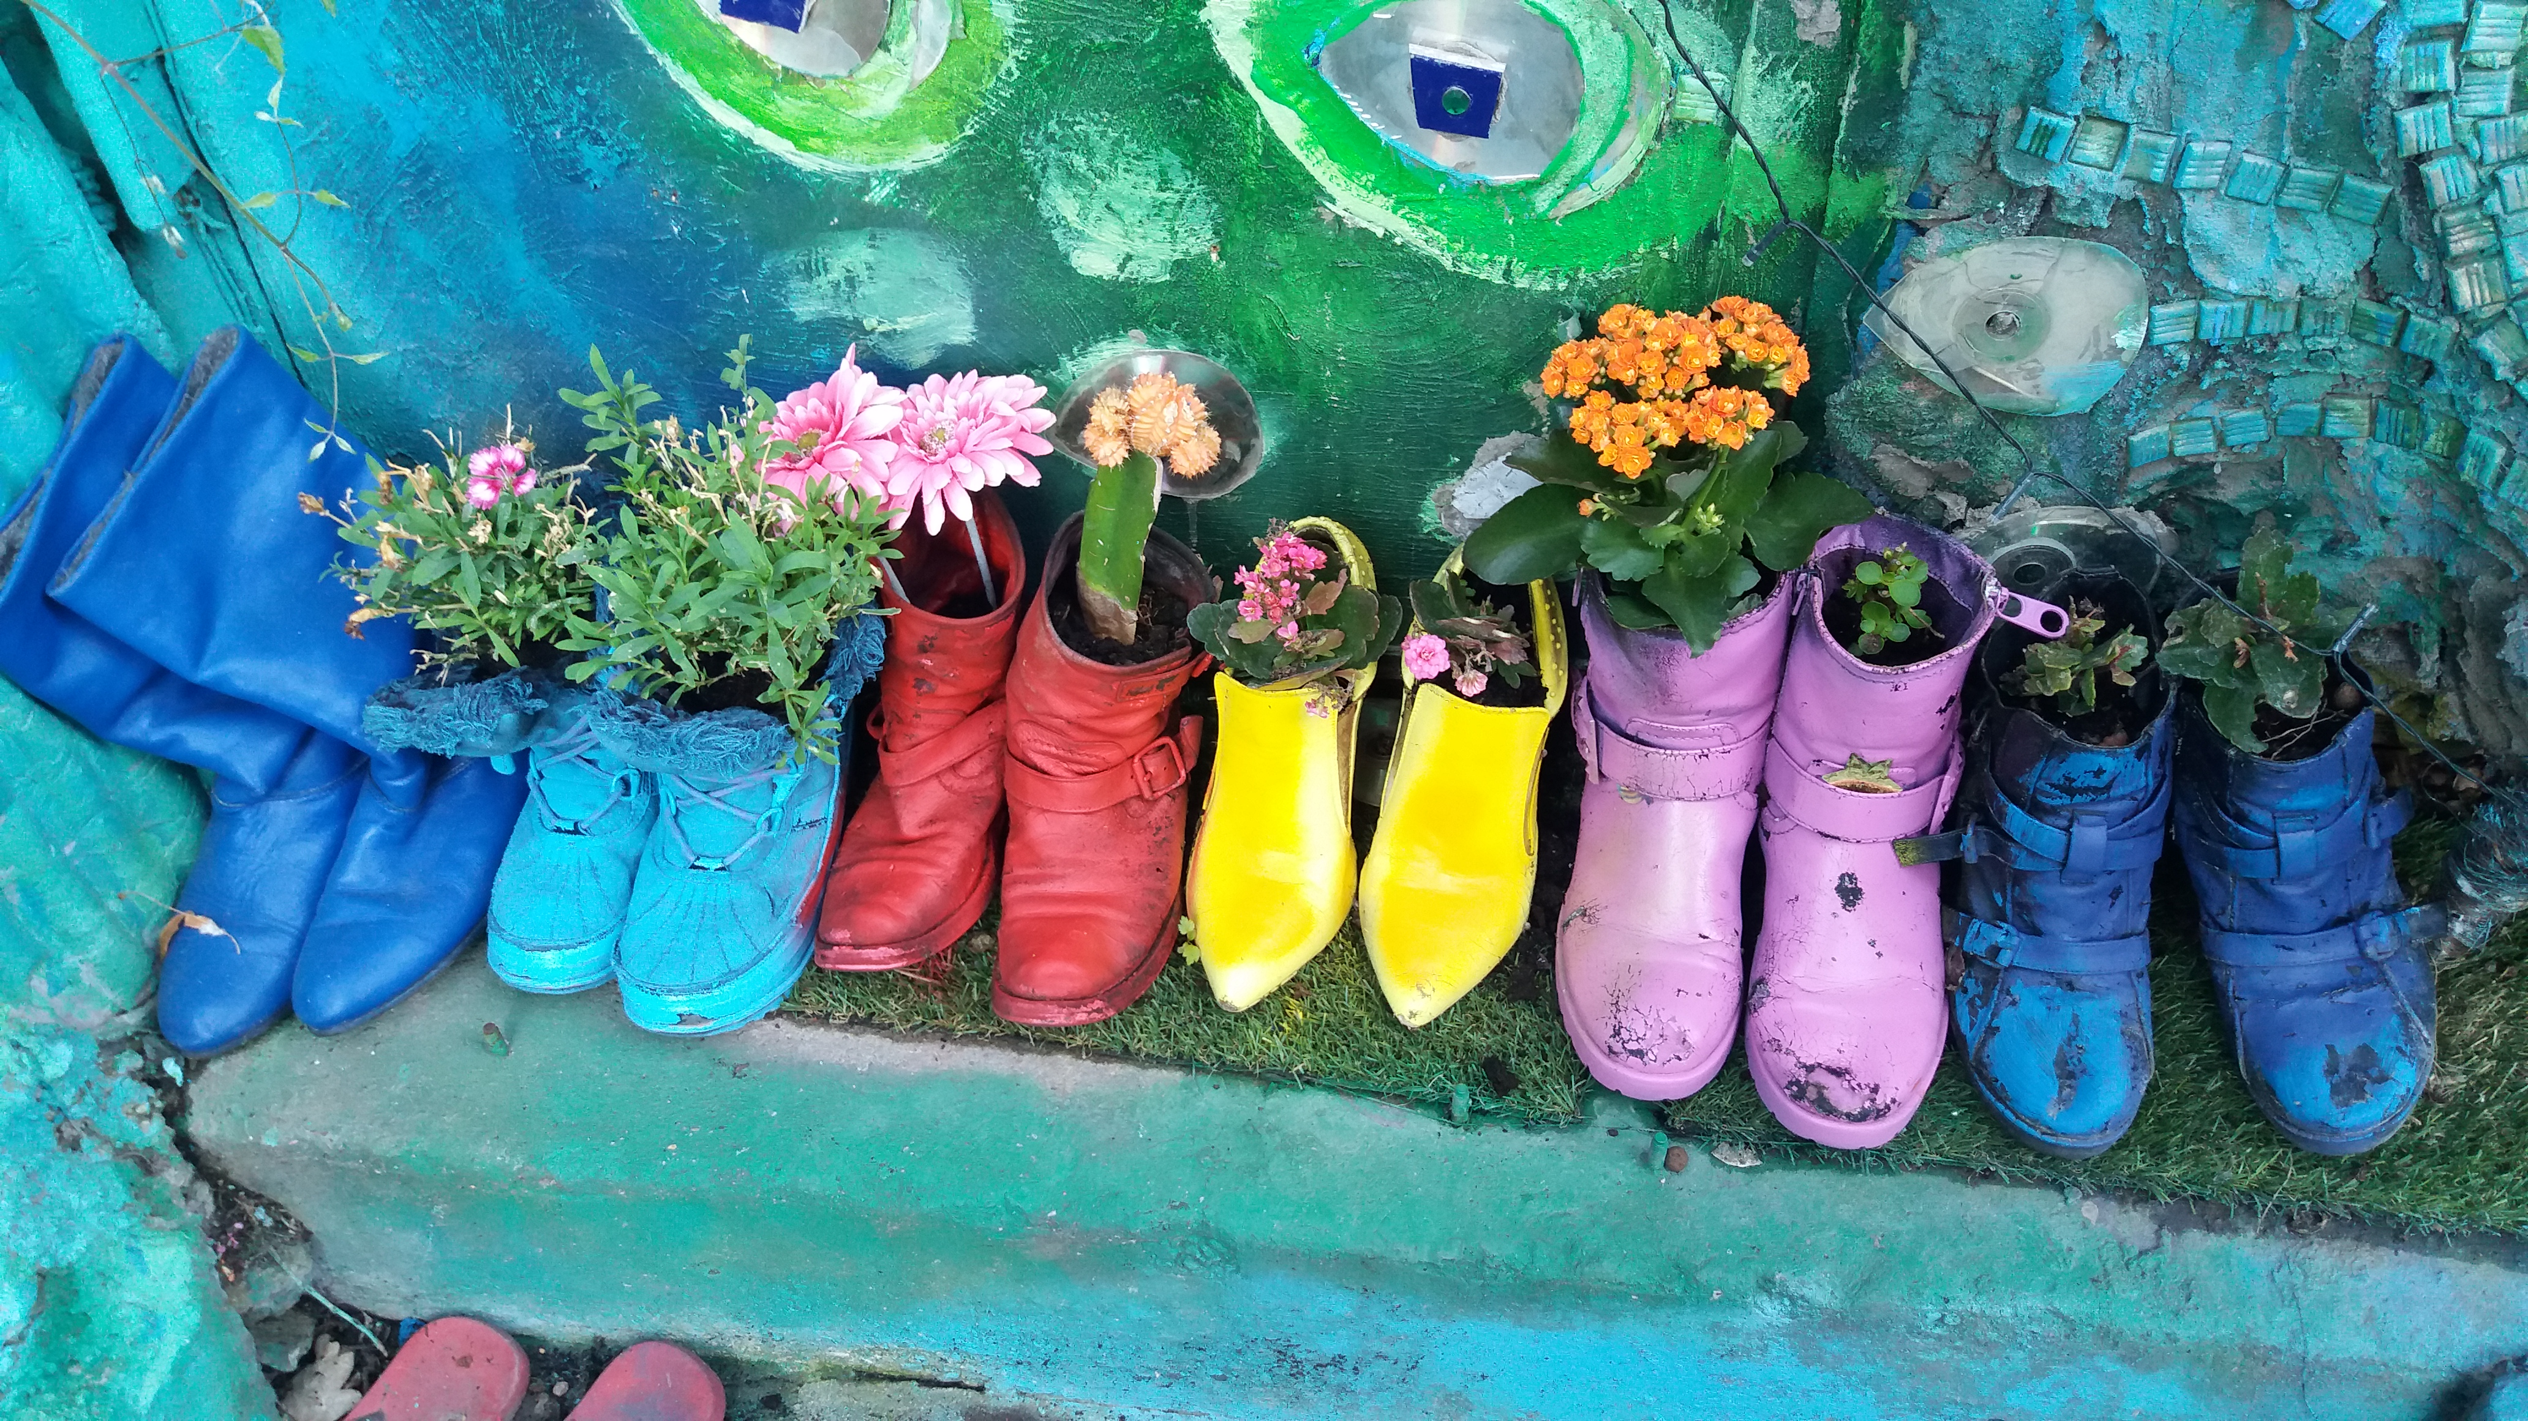
Co-Pilot for all – How can AI support the EEA?
People, Skills & Ways of Working
Worker productivity and production of knowledge and reports
Knowledge exploration services
Data analysis, exploration, visualisation, advanced analytics, image treatment and quality
© Grazia Ciancitto, Environment&Me 2025 / EEA

Slide 8
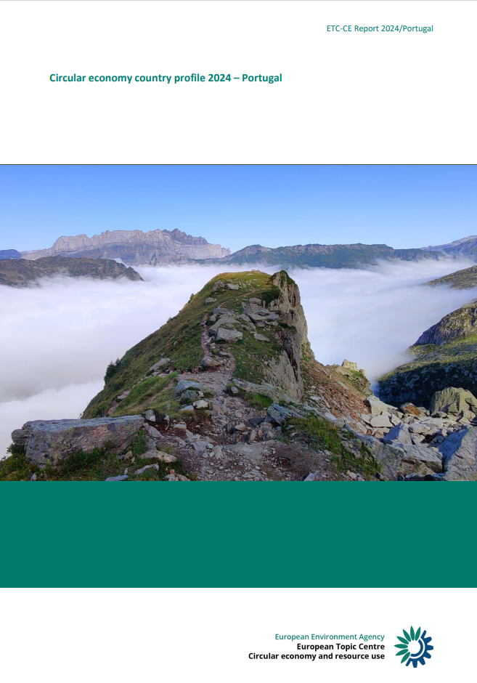
Applications of AI to support Member States
People, Skills & Ways of Working
Generation of Country profiles
  Circular Economy (CE) country profiles
  In collaboration with ETC CE
  Automatic generation of report from national documents and questionnaire
  MS need to review
  All languages supported
  Technology
  Using LLM to collect information and transforming it into structured information
  Train LLM to create country profiles from various data sources and profile-constrains

Slide 9
USE CASES
T3 Data, Technologies and Infrastructure

Slide 10
From fragmented workflows to production-ready pipelines
Data, Technologies & Infrastructure
AI-assisted automation for environmental data processing
2
Challenge / opportunity
3
Proposed use of AI
4
Scope
Heterogeneous sources and stable but labour-intensive methods make data pipelines slow to build, costly to maintain and vulnerable to concentrated expertise.
An IDE-based AI co-developer supports coding, debugging, documentation and testing; an agent can execute multi-step development workflows under human control.
AI-assisted collection from files, databases and APIs; processing, harmonisation, enrichment and metrics; conversion for reporting, publication or downstream use.
5
Expected outcome
6
Environmental + digital contribution
7
Key conditions
Potentially shift delivery from days to hours, improve consistency and test coverage, reduce mapping and conversion errors, and simplify onboarding.
More timely and reliable statistics, broader data coverage and fewer manual steps, while building AI capability and reusable, machine-readable pipelines.
Supported toolchain, sandboxed execution, Git and CI controls, sanitized prompts, cost-aware model choices, plus mandatory engineer and subject-matter validation.
MAIN TAKEAWAYS
01
02
03
04
Faster pipelines,
stronger assurance
Development speed
Quality by default
Knowledge continuity
Governed oversight
Generate new pipelines, adapters and calculations in substantially shorter cycles.
Consistent style, documentation, unit tests and security checks become part of every workflow.
AI can explain and extend existing code, reducing dependency on a single specialist.
Generated code remains a draft: engineers approve it and experts test outputs before production.
AI compresses development cycles while keeping accountability with data engineers and environmental subject-matter experts.
Notes:
Source: User-provided AI use case description, “AI-assisted automation for environmental data processing”.
[Sources]
- User-provided content in this conversation
[/Sources]

Slide 11
From external compute dependency to shared in-house capability
Data, Technologies & Infrastructure
Shared µHPC infrastructure for environmental research and AI
Secondary: People, Skills & Ways of Working
2
Challenge / opportunity
3
Proposed use of AI
4
Scope
Data-intensive research relies on external systems because no central scientific and AI compute is available. Workflows remain hard to reuse and expertise stays outside the administration.
Operate a browser-accessible µHPC: 4 nodes, 1,024 CPU cores, 32 NVIDIA H200 GPUs, 12 TB RAM and 500 TB NVMe. Open OnDemand provides JupyterLab, RStudio, QGIS and SLURM; SAIA adds internal LLM inference and API access.
Externally hosted, five-year supported service for UBA, BfN, BfS and BASE. Supports individual data science, shared TB-scale workspaces and hosted applications. Phased rollout from KI-Lab and early adopters across the portfolio.
5
Expected outcome
6
Environmental + digital contribution
7
Key conditions
Researchers run data- and GPU-intensive work in-house with reusable workflows and shared documentation. Success means stable operation, growing cross-agency use, reference cases and an LLM service reused by applications.
Strengthens monitoring and policy evidence through geodata, modelling and in-silico methods. Builds secure, reusable capability inside government, with measurable energy use and sustainable data-centre operation.
Portfolio identity and SSO for phase 3; defined data-protection levels; enablement and support capacity; continuity beyond 2029; and reuse focused on architecture, configuration and operating experience, not compute capacity.
MAIN TAKEAWAYS
01
02
03
04
Shared compute,
capability retained
Scientific scale
Access without friction
Reusable portfolio service
Adoption is the constraint
High-memory CPU and H200 GPU capacity supports remote sensing, modelling, bio- and chemoinformatics and language models.
Browser-based tools remove specialist client setup and give users common environments for analysis and collaboration.
Shared workspaces, hosted applications and API-based LLM inference turn isolated projects into reusable capability across four agencies.
SSO, data classification, enablement, support capacity and post-2029 continuity determine whether infrastructure becomes a durable service.
A shared µHPC brings advanced environmental research and AI workloads into a reusable portfolio service, while building methods, skills and operating knowledge inside the administration.
Notes:
Source: User-provided AI use case description, “Shared µHPC infrastructure for environmental research and AI”.
[Sources]
- User-provided content in this conversation
- EEA/Eionet reference design: FOEN_Internal_Environmental_Data_Chatbot.pptx
[/Sources]

Slide 12
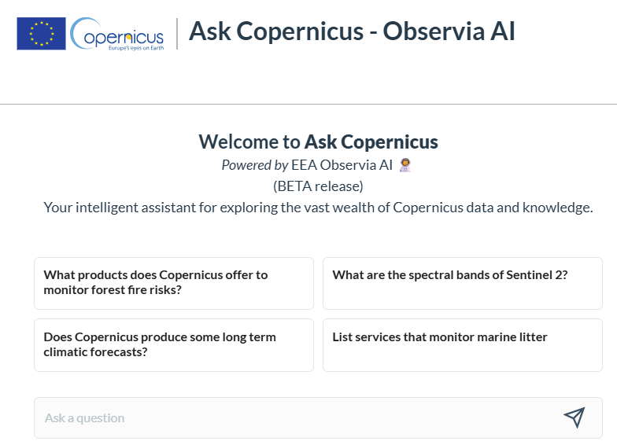
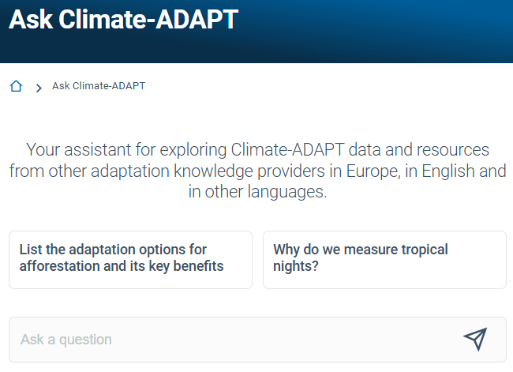
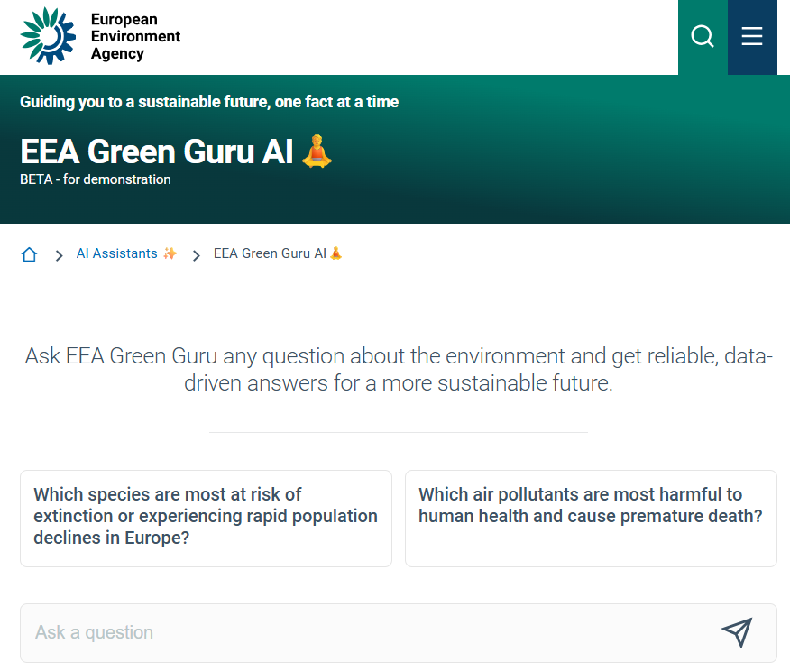
EEA GPT-Lab - Gen AI Architecture overview
Data, Technologies & Infrastructure
Check the AI's answer for correctness by comparing it with the referenced sources.
AI assistants are incorporated into a range of web platforms.
🕵🏻AI Claim verification
Provide the user with an accuracy report as part of the response.
Assistants API
EEA GPT-Lab
Gen AI Advanced RAG system
Knowledge source connectors
Authoritative knowledge
Prompts library
Assistants library
LLM Providers
library
Tools library
(web search, sql, create excel, charting, send email, book events...)
Knowledge base
EEA Reports, Briefings,
Indicators, data catalogues, technical documentation. FAQs, selected websites
LLM APIs Gateway
(rate-limits, guardrails...)
Logs
Monitoring & Evaluations
Private/Sensitive/Any docs
Public docs / non-SNC
Any cloud LLM APIs​
Data Science Workspaces
Local LLM APIs
LLMOps

Slide 13
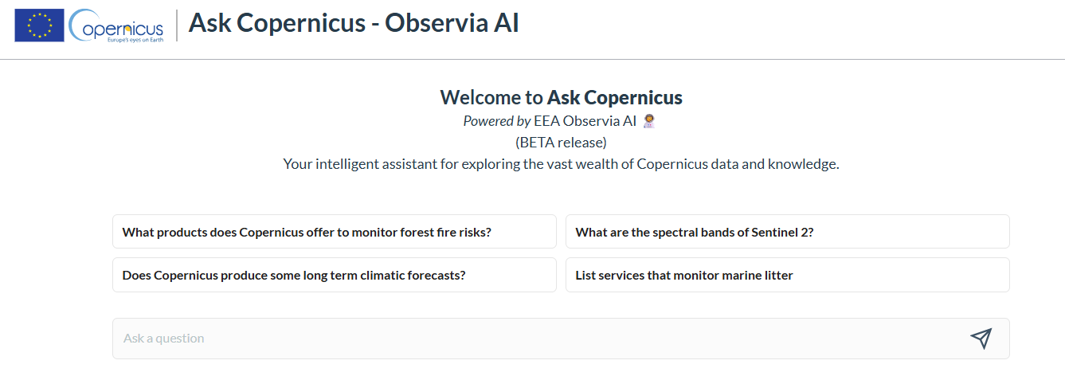
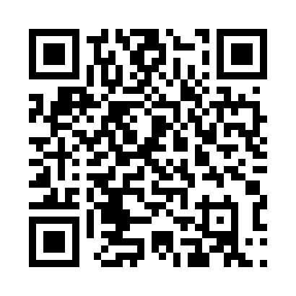
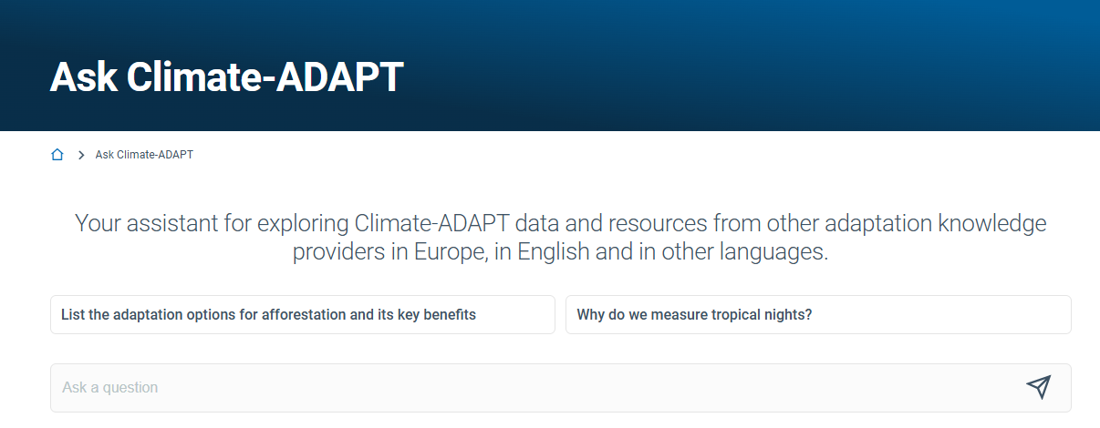
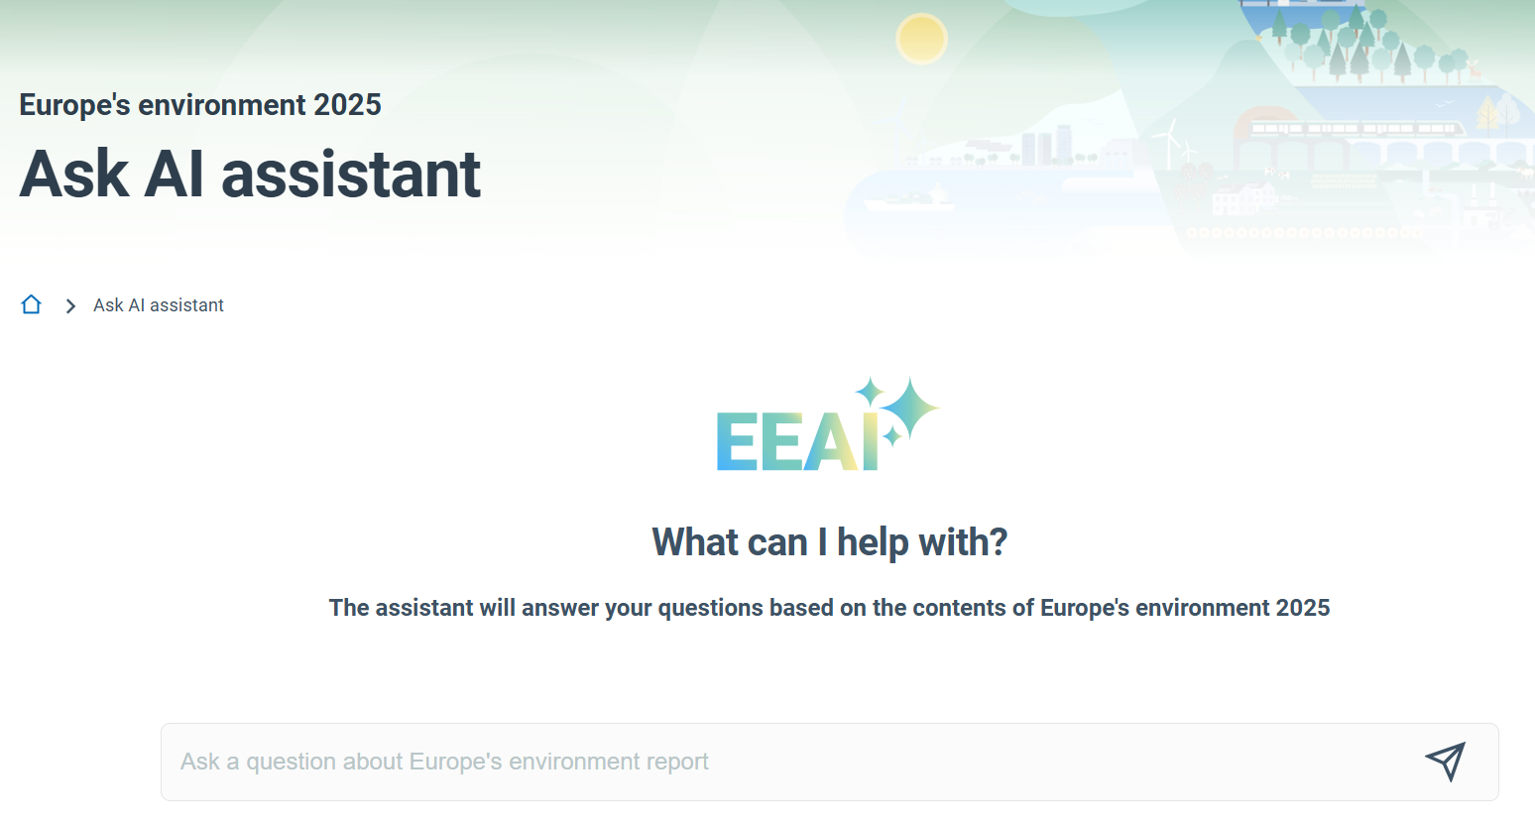
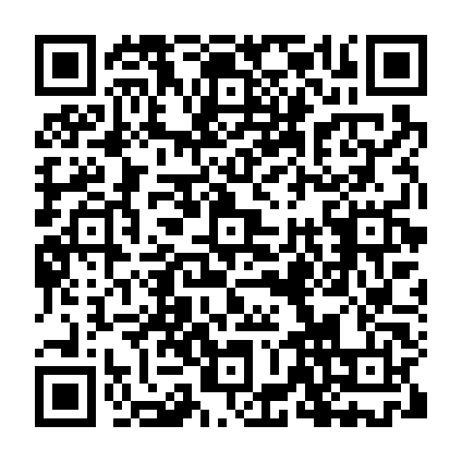
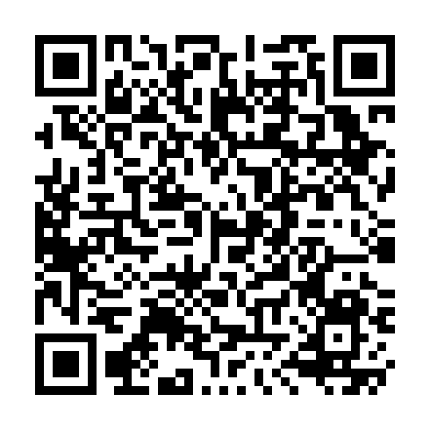
EEA AI assistants overview
Data, Technologies & Infrastructure
Ask Copernicus
Ask Climate-ADAPT
Ask AI assistant | Europe's environment 2025 (EEA)

Slide 14
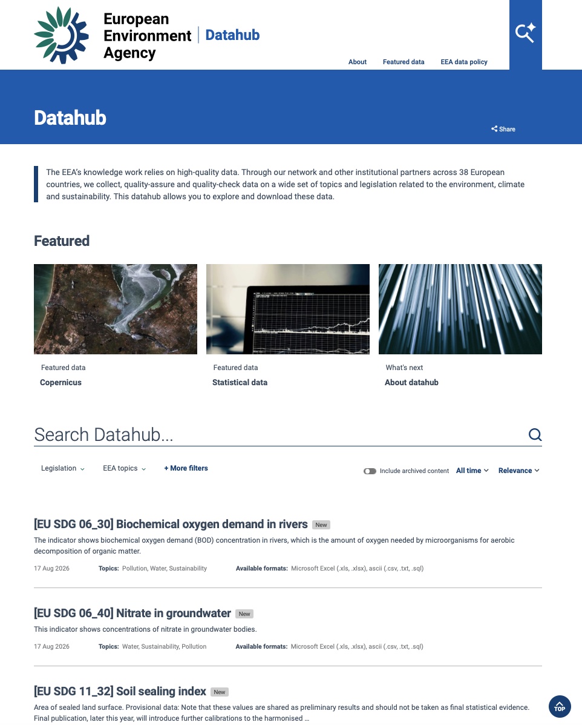
Better access to our data
Data, Technologies & Infrastructure
Go beyond the conventional “catalogue for data download”
Provide better navigation
Make data viewing priority
Streamline data accessiblity (for example AI accesible)
Recognise users backgrounds and provide ready data
One technology stack and one consultancy team

Slide 15
USE CASES
T4 AI Applications and Value Creation

Slide 16
From scattered information to trusted answers
AI Applications & Value Creation
FOEN Internal environmental data chatbot
2
Challenge / opportunity
3
Proposed use of AI
4
Scope
Knowledge is scattered across dossiers, internal repositories and public publications, making retrieval slow and access uneven.
A conversational assistant searches trusted sources and returns context-aware, source-referenced answers in natural language.
Question answering, document linking and summarisation, plus simple calculations and analysis. No automated technical or legal decisions.
5
Expected outcome
6
Environmental + digital contribution
7
Key conditions
Faster information retrieval, more consistent access to knowledge, traceable sources and positive user acceptance.
Improves evidence access and decision support while strengthening connected data management and responsible AI adoption.
Clear access controls, current knowledge, mandatory human review, reusable design and active management of external model dependency.
MAIN TAKEAWAYS
01
02
03
04
Trusted knowledge, at the point of need
Faster access
Traceable by design
Human judgement retained
Reusable foundation
One interface across internal dossiers and public FOEN knowledge.
Answers link back to current, authoritative source material.
Technical and legal conclusions remain subject to expert review.
A governed design can support additional internal AI use cases.
The assistant accelerates access to environmental knowledge without transferring accountability away from specialists.
Notes:
Source: Template for drafting an AI use case_km.docx, FOEN internal environmental data chatbot description. Retrieved from EEA/Eionet SharePoint.
[Sources]
- https://eea1.sharepoint.com/teams/-EXT-Eionet/_layouts/15/DocIdRedir.aspx?ID=EIONET-1333827832-65207
[/Sources]

Slide 17
From complex national plans to consistent assessment
AI Applications & Value Creation
AI Assisted Assessment of Nature Restoration Plans
2
Challenge / opportunity
3
Proposed use of AI
4
Scope
Dozens of long, structurally complex National Restoration Plans must be assessed against a detailed analytical grid. Manual review is slow and places heavy demands on limited expert capacity.
An LLM pre-assesses each plan, proposes criterion-level ratings and links every finding to supporting source text. Experts review and adjust all outputs through a simple web interface.
Pre-assessment of draft and final National Restoration Plans against the ETC-DI analytical grid. Supports EEA/ETC-DI experts; no automated approval or rejection.
5
Expected outcome
6
Environmental + digital contribution
7
Key conditions
Faster and more consistent first-pass assessments, structured referenced drafts and generated reports. Success: shorter turnaround, consistent grid use and positive assessor feedback.
Strengthens timely, consistent feedback under the Nature Restoration Law. Demonstrates scalable, reusable and responsible AI for reporting workflows with human oversight.
Parseable ReportNet 3 submissions; transparent source traceability; mandatory human review; model-agnostic infrastructure; reusable design and active management of model/vendor dependency.
MAIN TAKEAWAYS
01
02
03
04
Expert judgement,
accelerated by AI
Faster first pass
Traceable by design
Human oversight retained
Reusable architecture
Automates repetitive grid completion so experts can focus on judgement-intensive review.
Every proposed rating is linked to supporting evidence in the submitted plan.
AI outputs remain drafts; assessors validate and amend every conclusion.
Model-agnostic deployment supports different hardware and future reporting dataflows.
The tool turns each plan into a structured, referenced draft assessment while keeping every rating under expert control.
Notes:
Source: User-provided AI use case description, “AI Assisted Assessment of Nature Restoration Plans”.
[Sources]
- User-provided content in this conversation
[/Sources]

Slide 18
From API complexity to plain-language water status
AI Applications & Value Creation
POC hydrological state reporting using an MCP server for VMM data
2
Challenge / opportunity
3
Proposed use of AI
4
Scope
Water information is exposed through the KiWIS REST API, while hydrological reporting requires manual cross-checking across stations, catchments and external sources.
An MCP server exposes selected waterinfo.be API functions as trusted tools for an LLM that can retrieve, compare and explain current hydrological observations.
Proof of concept for levels, discharge, precipitation, physical and chemical parameters, and radar-derived QPE. Focus on retrieval, synthesis and bulletin drafting.
5
Expected outcome
6
Environmental + digital contribution
7
Key conditions
Faster preparation of hydrological state reports and rapid, plain-language answers for management, crisis cells and partner agencies.
Improves access to operational water intelligence while reusing existing APIs and testing a standards-based path for LLM-enabled public-sector data services.
Authoritative station metadata, reliable API access, clear source and timestamp display, controlled tool permissions, and expert validation before operational use.
MAIN TAKEAWAYS
01
02
03
04
Water status,
without the API barrier
Faster reporting
API access simplified
Current evidence
Reusable interface
Reduces manual cross-referencing across stations, catchments and data sources.
Lets non-specialists ask plain-language questions without mastering KiWIS syntax.
Grounds summaries in selected live measurements with visible source and timing.
MCP connects LLM workflows to the existing API without rebuilding the underlying infrastructure.
The POC turns live VMM measurements into rapid, source-grounded hydrological summaries while keeping interpretation and reporting under expert control.
Notes:
Source: User-provided AI use case description, “POC hydrological state reporting using an MCP server for VMM data on waterinfo.be”.
[Sources]
- User-provided content in this conversation
[/Sources]

Slide 19
From isolated pilots to governed AI at scale
AI Applications & Value Creation
ENVAI: responsible AI support for environmental administration and ICT activities
2
Challenge / opportunity
3
Proposed use of AI
4
Scope
Isolated pilots, manual data and model preparation, no shared register or operating environment. Repeated effort and deployment cycles often exceed 12 months.
A shared platform for search, classification, extraction, summarisation, anomaly detection, data-quality control and language services, integrated into sectoral systems.
Cross-cutting support for processes P1-P9 and services S1-S9 across MZP SR, SAZP and sectoral bodies. No autonomous administrative decisions.
5
Expected outcome
6
Environmental + digital contribution
7
Key conditions
Reduce approved-use-case-to-pilot time from >12 to about 6 months. Register by Q1 2029, platform by Q1 2030 and AI assistance by Q4 2030.
Faster access to evidence, earlier anomaly and change detection, reusable AI services, stronger data governance and secure integration through documented interfaces.
Fit-for-purpose data, EU and Slovak compliance, secure environments, traceable outputs, human oversight, integration capacity, skills and continuous model monitoring.
MAIN TAKEAWAYS
01
02
03
04
Shared AI capability,
accountable by design
Faster path to value
One governed foundation
Human decisions retained
Environmental intelligence
Cuts the target pilot cycle from more than 12 months to about six through reusable services and controlled deployment.
A common use-case register, MLOps environment, monitoring and audit trail make AI visible, reusable and manageable.
AI supports analysis and prioritisation; competent employees validate outputs and remain accountable for all decisions.
Search, extraction and anomaly detection help experts act earlier on complex documents, measurements and spatial change.
ENVAI turns fragmented experimentation into a reusable sector-wide capability while keeping every administrative, enforcement and policy decision under human responsibility.
Notes:
Source: User-provided AI use case description, "ENVAI: Responsible AI support for environmental administration and ICT activities".
[Sources]
- User-provided content in this conversation
- EEA/Eionet reference design: FOEN_Internal_Environmental_Data_Chatbot.pptx
[/Sources]

Slide 20
From information overload to trusted environmental answers
AI Applications & Value Creation
AI-driven environmental knowledge base
2
Challenge / opportunity
3
Proposed use of AI
4
Scope
Environmental knowledge is expanding rapidly, but verified information is hard to locate across millions of documents. Open search and consumer AI can return unverified or inaccurate content.
Create a specialised knowledge base using content only from selected trusted institutions. A RAG assistant retrieves source-grounded evidence instead of relying on open-internet knowledge.
Question answering with citations; keyword and semantic search; single-document and corpus summaries; draft writing across environment, energy, transport, climate and housing.
5
Expected outcome
6
Environmental + digital contribution
7
Key conditions
Faster, more reliable search and summarisation through a conversational agent that identifies the source behind each answer. The trusted corpus can expand over time.
Accelerates access to verified evidence, supports faster assessment and counters misinformation. In-house control, governed ingestion and modular collections support scalable reuse.
RAG architecture, authoritative collections, monitoring for hallucinations and omissions, response rejection where needed, optional human validation and controlled staff/partner use.
MAIN TAKEAWAYS
01
02
03
04
Trusted evidence,
ready for use
Authoritative by design
Traceable answers
Faster knowledge work
Scalable, governed foundation
Answers are grounded only in selected government, intergovernmental, regulatory and accredited research sources.
Every response cites its supporting source, enabling users to verify claims and reuse evidence confidently.
Natural-language search, semantic retrieval, summarisation and drafting reduce time spent finding and synthesising material.
Modular thematic collections improve retrieval precision and allow new sources, topics and user groups to be added over time.
A governed environmental knowledge base turns a growing body of trusted publications into fast, traceable answers while keeping quality control and accountability in human hands.
Notes:
Source: User-provided AI use case description, “AI-driven environmental KB (Knowledge Base)”.
[Sources]
- User-provided content in this conversation
- EEA/Eionet reference design: FOEN_Internal_Environmental_Data_Chatbot.pptx
[/Sources]

Slide 21
From complex permits to smarter environmental reporting
AI Applications & Value Creation
AI-enabled structuring of permit conditions for digital reporting
2
Challenge / opportunity
3
Proposed use of AI
4
Scope
Complex, non-machine-readable permits require substantial manual interpretation by operators and supervisory authorities.
Extract and structure permit conditions and reporting information to tailor questions and support automated compliance checks.
Permits and environmental reports for the future digital reporting system, serving operators, authorities and the Agency.
5
Expected outcome
6
Environmental + digital contribution
7
Key conditions
Simpler, faster facility-specific reporting for operators and more efficient compliance checks and follow-up for authorities.
Improves reporting and oversight while strengthening accessible, reusable, interoperable data and trustworthy public-sector AI.
Representative documents, defined quality criteria, human validation, legal traceability and reusable data structures.
MAIN TAKEAWAYS
01
02
03
04
Structured permits,
smarter reporting
Less reporting burden
Compliance support
Traceable and reliable
Reusable data foundation
Facility-specific questions reduce manual interpretation and unnecessary reporting effort.
Structured conditions enable more efficient checks and follow-up by supervisory authorities.
Human validation protects accuracy, legal interpretation and confidence in extracted information.
Interoperable structures support future services, analysis and additional public-sector use cases.
AI turns complex legal documents into structured, traceable information while keeping legal interpretation and accountability under human control.
Notes:
Source: User-provided AI use case description, “Environmental reporting”.
[Sources]
- User-provided content in this conversation
- EEA/Eionet reference design: FOEN_Internal_Environmental_Data_Chatbot.pptx
[/Sources]

Slide 22
From hidden budget data to climate-risk intelligence
AI Applications & Value Creation
AI use case: physical risk data extraction for green budgeting applications
2
Challenge / opportunity
3
Proposed use of AI
4
Scope
Green budgeting is constrained by missing asset-level risk data. Yet geolocation and asset-type clues often remain locked in unstructured municipal budget records.
Within a Hazard–Exposure–Vulnerability model, AI extracts geolocations and asset types from budget line items; a human-validation workflow safeguards quality.
Local AI prototype using Austrian municipalities’ budget data. Focus on geodata extraction and asset classification, not automated risk or spending decisions.
5
Expected outcome
6
Environmental + digital contribution
7
Key conditions
Automated extraction of physical-risk data points creates a prerequisite for assessing public-budget exposure and managing growing systemic climate risks.
Connects climate-risk evidence with public finance, turns semi-structured records into reusable data and demonstrates responsible AI for greener budgeting.
Representative budget formats, agreed asset taxonomy, geolocation confidence thresholds, auditable outputs, privacy controls and proportionate human validation.
MAIN TAKEAWAYS
01
02
03
04
Physical-risk data,
made budget-ready
Close critical data gaps
Enable risk assessment
Human validation at scale
Greener financial decisions
Recover geolocation and asset-type evidence already embedded in public budget records.
Create structured inputs for exposure and vulnerability analysis in the HEV model.
Route uncertain or high-impact extractions to reviewers through a proportionate workflow.
Give public authorities a stronger evidence base for climate-aware budgeting and risk management.
AI converts overlooked information in municipal budgets into structured evidence for climate-risk assessment, while keeping validation and financial decisions under human control.
Notes:
Source: User-provided AI use case description, “physical risk data extraction for green budgeting applications”.
[Sources]
- User-provided content in this conversation
- EEA/Eionet reference design: FOEN_Internal_Environmental_Data_Chatbot.pptx
[/Sources]

Slide 23
From fragmented assessment practices to consistent, AI-supported decisions
AI Applications & Value Creation
Impact Assessment in the Age of Artificial Intelligence – Italian experience
2
Challenge / opportunity
3
Proposed use of AI
4
Scope
Different authorities apply varied criteria and methods, creating inconsistent assessments and high demands on expert capacity.
Analyse technical documentation, baseline and monitoring data, consultation inputs and project information to generate traceable decision-support outputs.
EIA and SEA workflows across national, regional and local levels, including document management, impact analysis, cumulative effects and condition verification.
5
Expected outcome
6
Environmental + digital contribution
7
Key conditions
A shared Environmental Governance Platform with common knowledge frameworks, impact coding and interoperable data, deployed through regional pilots.
More systematic, evidence-based assessment and adaptive monitoring, combined with interoperable data, responsible automation and reusable digital services.
High-quality data, common methods, secure access, transparent and traceable outputs, expert skills, human oversight and monitoring of AI’s environmental footprint.
MAIN TAKEAWAYS
01
02
03
04
Consistent assessment,
accountable by design
Harmonised methods
Evidence at scale
Human authority retained
Reusable governance
Shared frameworks and impact coding reduce variation across national, regional and local procedures.
AI helps experts navigate large documentation sets, environmental data and cumulative impacts more efficiently.
AI provides decision support only; competent authorities validate evidence and remain responsible for final determinations.
The EGP supports pilots, interoperable services and progressive deployment across territories and administrative levels.
AI strengthens coordination, evidence use and consistency across competent authorities while final environmental judgements remain with accountable human experts.
Notes:
Source: User-provided AI use case description, “Impact Assessment in the Age of Artificial Intelligence – Italian experience”.
[Sources]
- User-provided content in this conversation
- EEA/Eionet reference design: FOEN_Internal_Environmental_Data_Chatbot.pptx
[/Sources]

Slide 24
From uncertain land take to spatially explicit foresight
AI Applications & Value Creation
AI-driven spatial foresight for soil loss in Italian metropolitan cities
2
Challenge / opportunity
3
Proposed use of AI
4
Scope
Soil loss depends on interacting demographic, hazard and policy drivers. Analysis must predict both how much land is sealed and precisely where change will occur.
Combine AI, geographical foundation models and spatial simulation to map future sealing, quantify prediction error and compare city-level results with historical trends.
MOLUSCE in QGIS uses Artificial Neural Networks for training and Cellular Automata for spatial simulation across Italy’s 14 metropolitan cities, including policy-based scenarios.
5
Expected outcome
6
Environmental + digital contribution
7
Key conditions
Scale scenario modelling from metropolitan cities to all Italy using CINECA supercomputing. Compare spatial forecasts with five-year trends and non-spatial simulations to guide planning and investment.
High-resolution maps to 2030 show the likely impact of policy choices, supporting soil protection, climate action, EU restoration objectives and the UN Sustainable Development Goals.
Verified input data, sufficient computing capacity, human oversight throughout, and a combination of AI literacy, advanced GIS and foresight expertise.
MAIN TAKEAWAYS
01
02
03
04
Spatial foresight,
policy choices made visible
Location matters
Policy scenarios
National scale
Decisions stay human
Forecasts show not only the amount of future soil sealing, but where it is most likely to occur.
Protected areas and restoration measures can be incorporated to compare plausible planning choices.
CINECA computing supports expansion from 14 metropolitan cities towards the full Italian territory.
Error metrics, historical validation and expert oversight keep outputs transparent and decision-relevant.
AI transforms complex 4D land-change dynamics into scenario maps that help authorities compare interventions while keeping model interpretation under expert control.
Notes:
Source: User-provided AI use case description, “AI-Driven Spatial Foresight for Soil Loss in Italian Metropolitan Cities”.
[Sources]
- User-provided content in this conversation
- EEA/Eionet reference design: FOEN_Internal_Environmental_Data_Chatbot.pptx
[/Sources]

Slide 25
From document chaos to organisational intelligence
AI Applications & Value Creation
Perseus · AI-based knowledge extraction, risk management and process support
2
Challenge / opportunity
3
Proposed use of AI
4
Scope
Critical knowledge remains fragmented across emails, documents and systems. Context is lost, risks are harder to manage and lessons from past decisions are difficult to reuse.
A local AI model reads sensitive documents, extracts summaries, risks, tasks, events and entities, then converts unstructured content into structured, searchable knowledge.
Document upload and processing; shared agenda knowledge base; JSON, ChromaDB and PostgreSQL. Users include project managers, agenda owners, team members and administrators.
5
Expected outcome
6
Environmental + digital contribution
7
Key conditions
Move from current extraction and reporting to learning from prior risks, decisions and processes, richer reporting, interactive chat and broader organisational process coverage.
Makes environmental evidence easier to find and reuse; automates routine knowledge work, strengthens cooperation and develops practical AI capability in public organisations.
Reliable source documents, strict access and ownership controls, GDPR compliance, human review, resilient local infrastructure and staff able to evaluate AI outputs critically.
MAIN TAKEAWAYS
01
02
03
04
Local knowledge,
organisational memory
Knowledge made usable
Local by design
Risks and decisions connected
Platform for learning processes
Extracts risks, tasks, events, people and decisions from files and connects them in a searchable organisational context.
Processes sensitive content within local infrastructure, reducing exposure while supporting controlled organisational access.
Links risks, mitigation, tasks and decisions so teams can reuse past experience and improve future responses.
Builds toward interactive chat, richer management views and processes that learn from their own history.
Perseus turns sensitive, unstructured resources into shared organisational knowledge, while keeping data local and decisions under human control.
Notes:
Source: User-provided AI use case description, “Perseus - AI-based system for extracting knowledge, managing risks and supporting organisational processes”.
[Sources]
- User-provided content in this conversation
- EEA/Eionet reference design: FOEN_Internal_Environmental_Data_Chatbot.pptx
[/Sources]

Slide 26
From incomplete turbine registers to precise spatial intelligence
AI Applications & Value Creation
AI detection of onshore wind turbines from satellite imagery
2
Challenge / opportunity
3
Proposed use of AI
4
Scope
Existing registers are incomplete or imprecise, yet accurate turbine locations are needed for weather radar, spatial planning and energy monitoring.
A repeatable pipeline processes PlanetScope RGB imagery and applies a YOLO object-detection model to locate turbines and publish versioned updates.
Germany, optionally with a 100 km buffer. Existing onshore turbines only; no offshore detection or derivation of rotor length or hub height.
5
Expected outcome
6
Environmental + digital contribution
7
Key conditions
A uniform, high-resolution location dataset supporting current-state mapping, time-series analysis, radar uncluttering and infrastructure-lifecycle monitoring.
Makes renewable-energy expansion measurable for spatial and land-use planning, using a standardised, machine-readable and extensible data foundation.
Timely, high-quality imagery; periodic human review; adaptation for changing turbine designs; and further model development for offshore or novel designs.
MAIN TAKEAWAYS
01
02
03
04
Wind infrastructure,
visible over time
Higher precision
Change over time
Operational value
Scalable foundation
Fills gaps in existing registers with a uniform, high-resolution geolocation dataset.
Versioned updates reveal construction and decommissioning for lifecycle and trend analysis.
Supports radar-data uncluttering, spatial planning and comparison with energy-yield information.
The pipeline can extend beyond Germany and incorporate complementary sources such as LiDAR.
Automated satellite-image analysis creates a consistent, updateable view of onshore turbines while retaining human quality assurance.
Source: User-provided AI use case description, “Detection of onshore wind turbines from satellite imagery”.
Notes:
Source: User-provided AI use case description, “Detection of onshore wind turbines from satellite imagery”.
[Sources]
- User-provided content in this conversation
- EEA/Eionet reference design: FOEN_Internal_Environmental_Data_Chatbot.pptx
[/Sources]

